Slide 1









TEAM NAME: IIP COLLEGE NAME: Panimalar Engineering College PROBLEM STATEMENT: Students spend hours scrolling short videos but gain little real learning from it.Traditional learning platforms are long, passive, and fail to build practical skills.

Slide 2

PROBLEM STATEMENT
Forum Of Data Science Engineers
Students today spend hours scrolling short-form content, yet most learning platforms still rely on long, passive courses that fail to keep them engaged. As a result, learners consume information but struggle to build real skills, practice communication, or prepare for interviews. The gap between how students learn and what the modern world demands continues to grow.

Slide 3
SOLUTION
Forum Of Data Science Engineers
• Reel-style learning: Courses delivered through short, engaging videos. • Quiz-based progression: Unlock the next level only after completing quizzes. • Gamified learning: Streaks, leaderboards, and certificates to motivate users. • Live Group Discussions: Join or spectate GD sessions to improve communication skills. • AI Mock Interviews: Role-based AI interviews with feedback to improve job readiness.

Slide 4
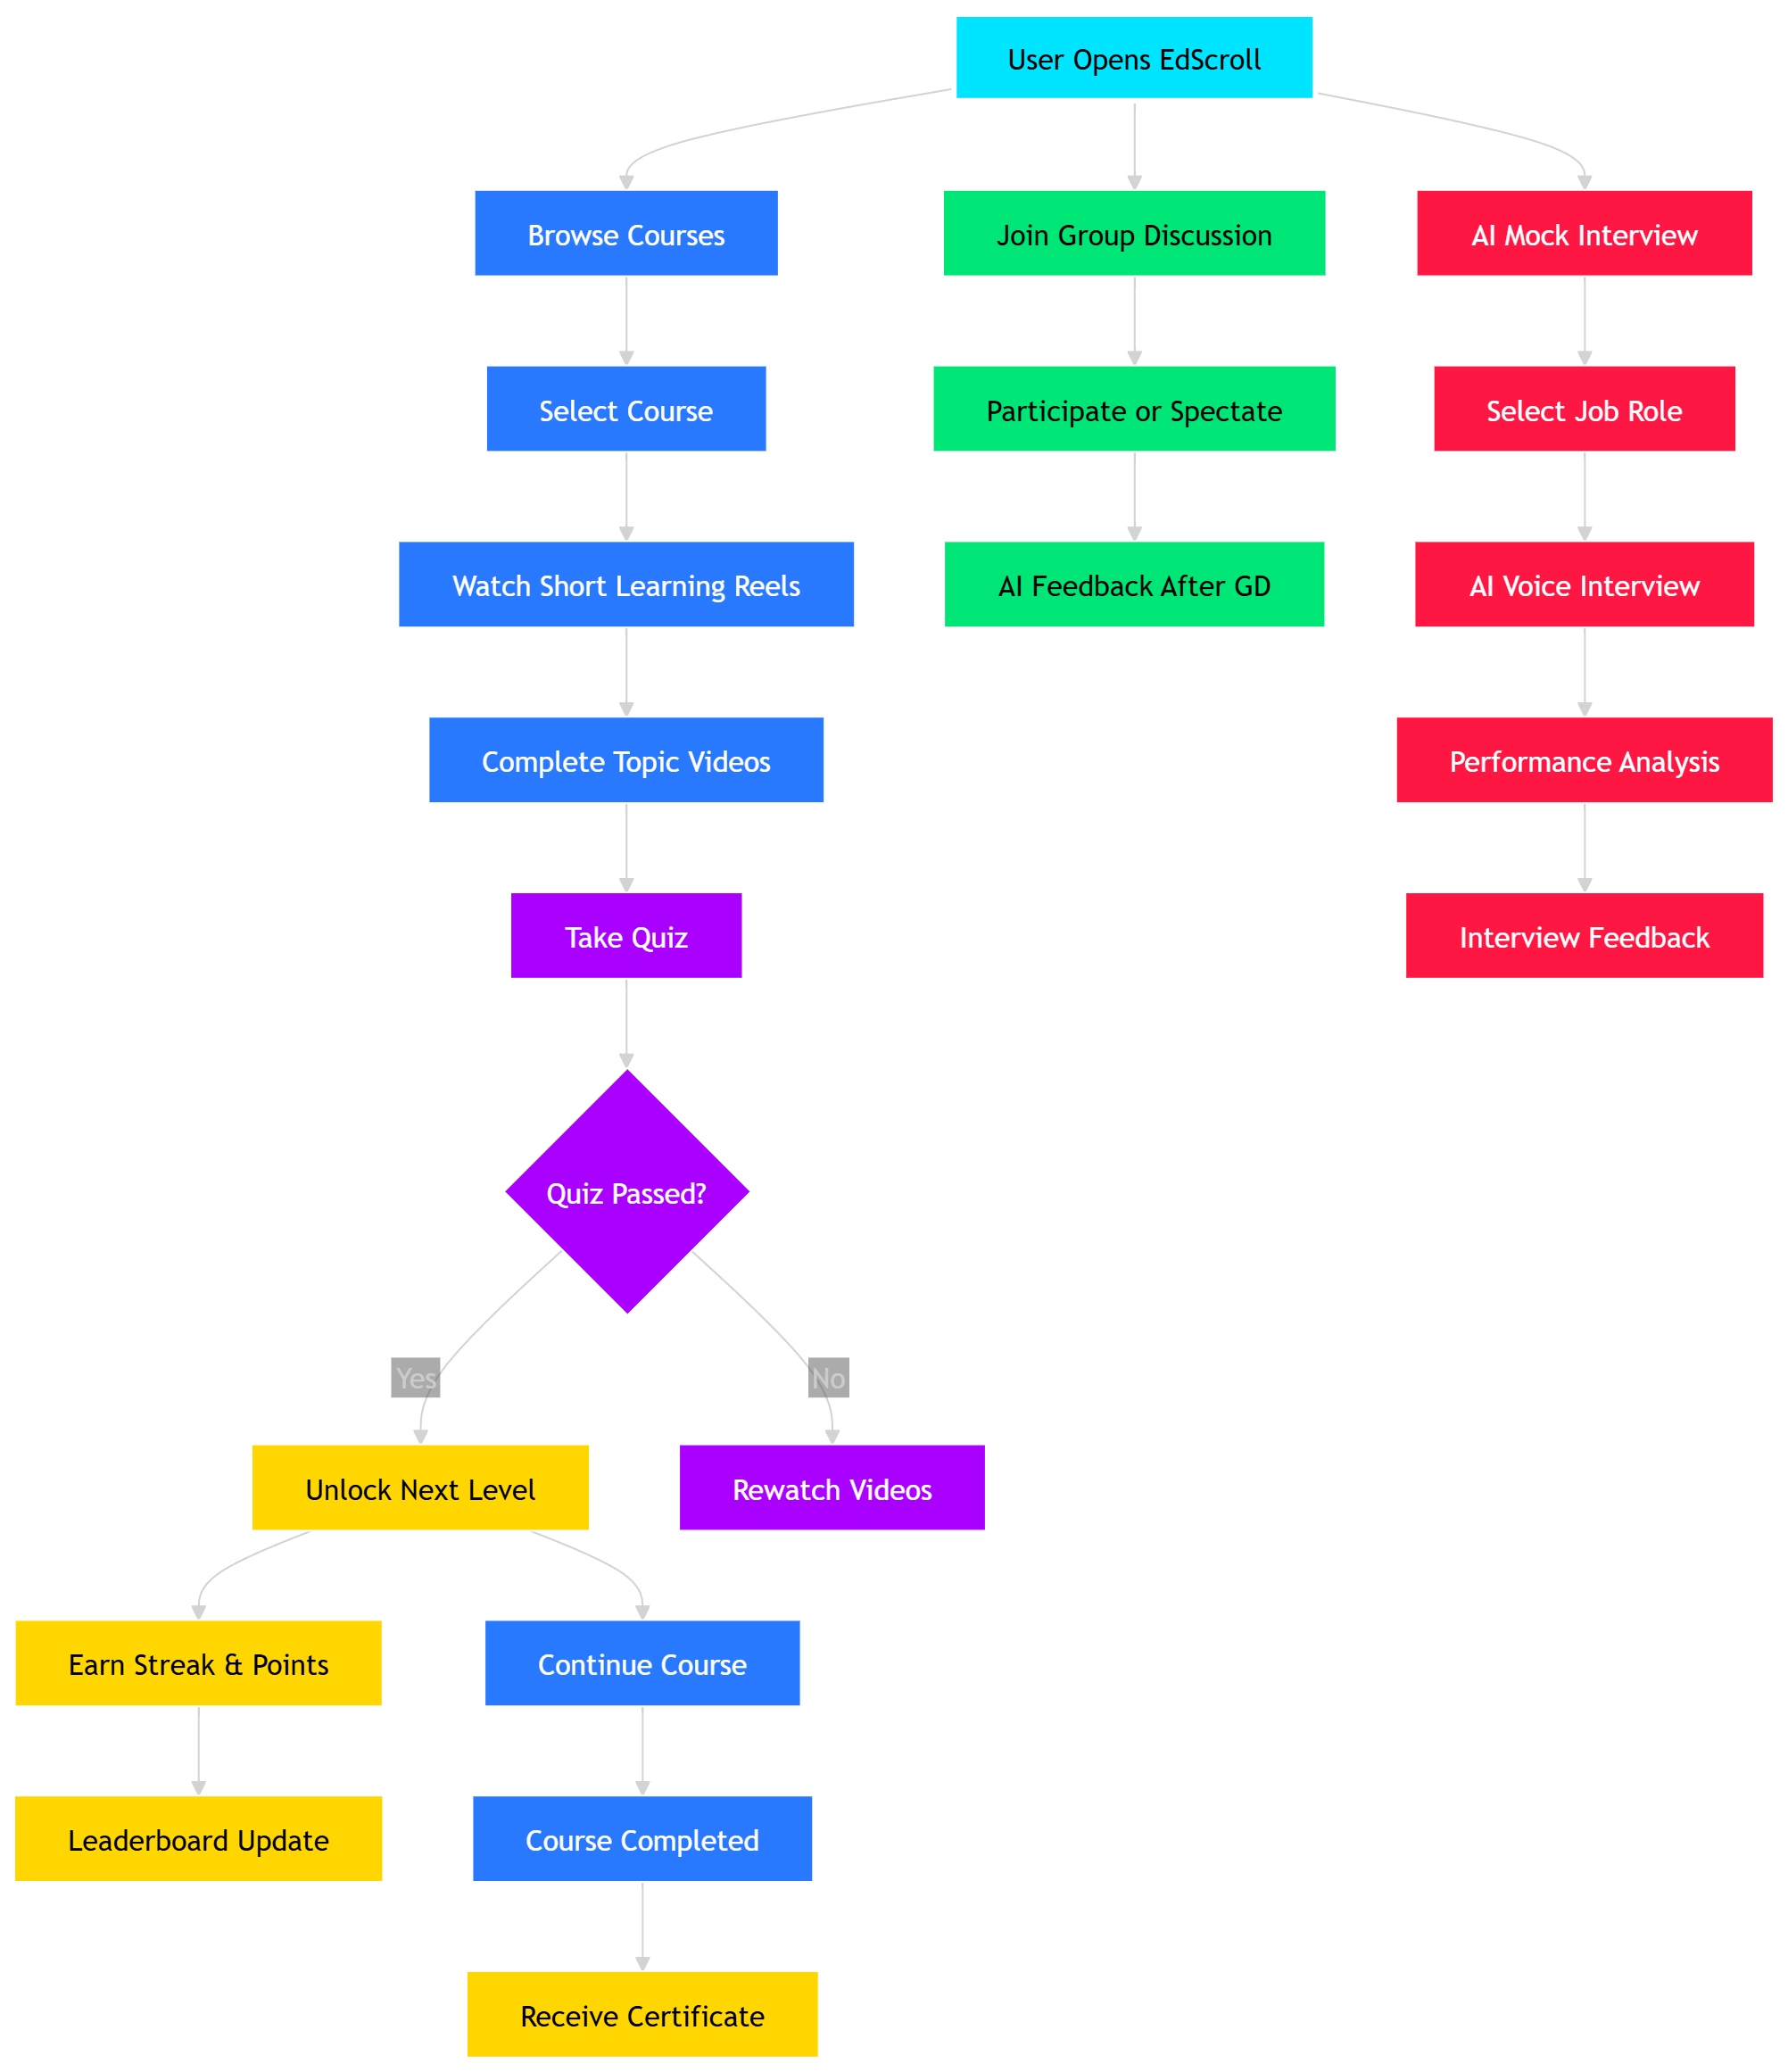
FLOW DIAGRAM
Forum Of Data Science Engineers

Slide 5
TECHNICAL REQUIREMENTS
Forum Of Data Science Engineers
• Frontend: Mobile/Web interface for reel-based learning using modern frameworks (React / Flutter). • Backend: Server-side logic to manage users, courses, quizzes, and discussions using Node.js or similar frameworks. • Database: Cloud-based database (MongoDB / Firebase) to store user data, course progress, scores, and certificates. • AI Integration: Speech recognition and NLP models for AI mock interviews and performance evaluation. • Video Delivery System: Efficient streaming/CDN support for smooth short-video learning content. • Real-time Communication: WebRTC or similar technology to enable live group discussion sessions. • Authentication & Security: Secure login, user authentication, and data protection mechanisms. • Cloud Hosting: Scalable deployment using cloud platforms for reliable performance and accessibility.

Slide 6
NOVELTY / USE CASE
Forum Of Data Science Engineers
• Transforms social media scrolling into structured skill learning through reel-based micro-courses. • Learning &Practice in one platform combines education, communication training, and interview preparation. • Spectate Mode for GDs allowing beginners to observe real discussions and learn before participating. • AI-powered mock interviews with voice interaction that simulate real interview environments and give instant feedback. • Gamified skill progression using quizzes, streaks, leaderboards, and certifications to keep learners consistently engaged.

Slide 7
BUSINESS MODEL / TARGET MARKET
Business Model: EdScroll follows a freemium model where users can access basic courses and learning features for free, while advanced features such as premium courses, AI-powered mock interviews, and verified certificates are offered through paid subscriptions. The platform can also generate revenue through partnerships with educational institutions, corporate training programs, and recruitment platforms that use EdScroll to identify skilled candidates.
Target Market: EdScroll primarily targets college students, job seekers, and young professionals who want to improve their skills in an engaging and modern way. It is also useful for educational institutions that want to provide practical learning tools for their students, as well as organizations looking for better ways to train and evaluate potential candidates.
Forum Of Data Science Engineers
D E S I G N . D E V E L O P . D E P L O Y

Slide 8
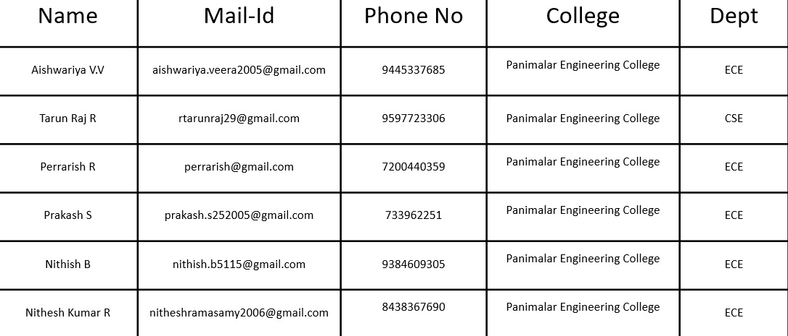
TEAM DETAILS
Forum Of Data Science Engineers
ROLE
NAME
STREAM/DEPT
YEAR
COLLEGE

